Slide 1

Digital Portfolio
STUDENT NAME:Jaya sri.G
REGISTER NO AND NMID: 222401244 and asunm11024ai134
DEPARTMENT: Bsc computer science with Artificial Intelligence
COLLEGE: Madras university
1

Slide 2

PROJECT TITLE
Student Digital Portfolio Using Frontend Development
2

Slide 3



AGENDA
Problem Statement
Project Overview
End Users
Tools and Technologies
Portfolio design and Layout
Features and Functionality
Results and Screenshots
Conclusion
Github Link
3/21/2024 Annual Review
3

Slide 4

PROBLEM STATEMENT
A portfolio website is like a digital resume that helps students showcase their skills, achievements, and projects in a clear, attractive, and professional way. Unlike plain documents, it’s interactive, easy to access, and makes it simple for teachers, recruiters, or collaborators to connect
4

Slide 5

PROJECT OVERVIEW
This is a personal portfolio website built using HTML, CSS, and JavaScript to showcase my profile, achievements, projects, and skills. It includes sections like Home, About, Achievements (with Google Drive certificate previews), Projects, Skills, and Contact. The site features smooth scrolling, active navbar highlighting, and animated skill bars. A responsive design. It also includes a contact form with instant submission alerts and links to my email/LinkedIn for easy communication.
5

Slide 6

WHO ARE THE END USERS?
Recruiters /Employers – to check your skills, projects, and achievements for job or internship opportunities.
Teachers / Professors – to evaluate your academic and project work.
Peers / Classmates – to collaborate on projects or learn from your work.
You (Owner) – to use it as a digital resume and personal branding tool.
6

Slide 7

TOOLS AND TECHNIQUES
1. HTML5 – to structure the content of the website.
2. CSS3 – for styling, layout, and responsive design.
3. JavaScript – to add interactivity like animations, skill bar effects, and form alerts.
4. Font Awesome – for adding professional icons.
5. Google Drive – to embed and showcase certificates.
6. Web Design Techniques – including smooth scrolling, active navbar highlighting, and card-based layouts.
7

Slide 8
POTFOLIO DESIGN AND LAYOUT
The design follows a clean, modern, and responsive layout with smooth navigation.
Sections are arranged vertically: Home, About, Achievements, Projects, Skills, and Contact.
The Home section has an intro text with a circular profile picture.
Achievements and Projects use a card-based gallery layout for neat presentation.
Skills are shown with animated progress bars.
Contact section includes both a form and direct contact details (email, LinkedIn).
A sticky navbar highlights the current section while scrolling.
The background uses gradients and soft colors for a visually appealing look.
8

Slide 9
FEATURES AND FUNCTIONALITY
1. Responsive design – works on mobile, tablet, and computer.
2. About section – quick intro with skills and education.
3. Project showcase – highlights my best works.
4. Achievements & certificates – shows my milestones.
5. Contact section – easy to reach me via email or social links.
6. Footer – contains my contact details & useful links.
7. Smooth navigation – simple and user-friendly flow.

Slide 10
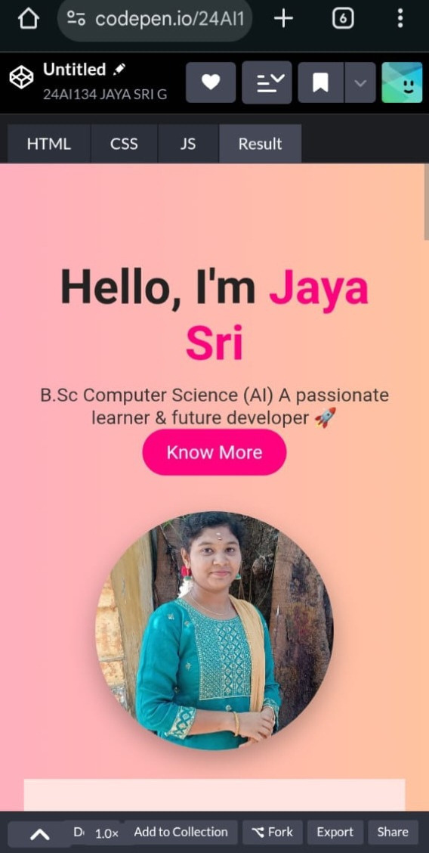
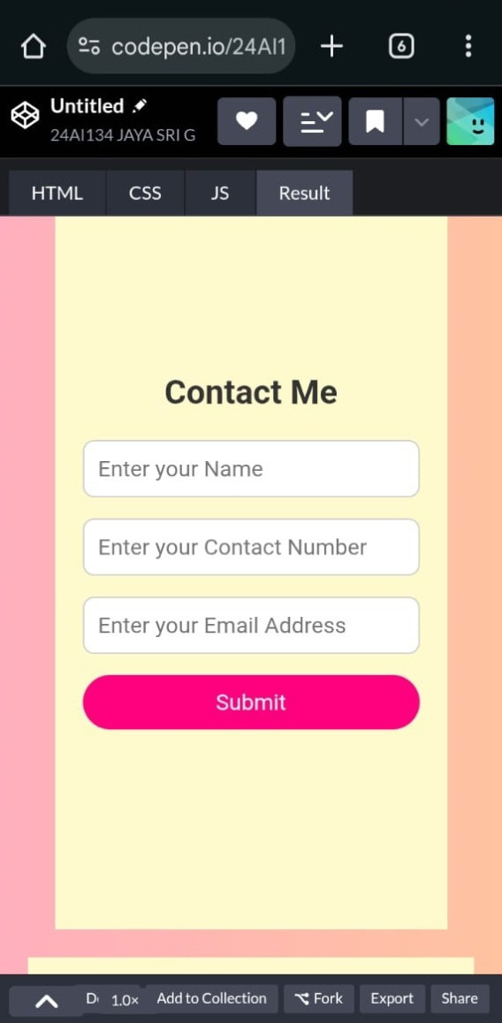

RESULTS AND SCREENSHOTS
Here the result’s screenshot:
3/21/2024 Annual Review
10

Slide 11
CONCLUSION
The portfolio successfully solves the problem of presenting personal/professional achievements in a modern, interactive way. It can be used for academic purposes, job applications, or networking. With further enhancements like a blog section or backend for storing form responses, it can be expanded into a complete professional portfolio system.
11

